Slide 1
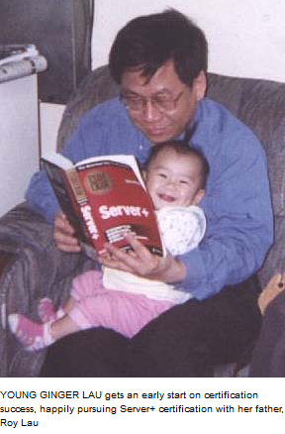
Subnetting in
60 seconds or less
Photo from www.roylau.com
The Ginger Method
by Mr. Roy Lau, P.E, PMP, MCT
Technical Career Institutes (TCI –College of Technology)
New York, NY 10001

Slide 2
Presented by
Mr. Roy Lau, P.E., PMP, MCT
CET/CEA/CST/CSS/CNST/NT-CIP/CCS/CSM/M-CAP
A+/N+/i-Net+/Sever+/CIW-A/Security+/IT Project+/Linux+/Security+/CTT+
CNA/CCNA/CCDA/MCP(XP,.NET)/MCP+I/MCSA
MCSE (Early Achiever) /MCDBA
Certification Administrator Of ETA; Senior Member of IEEE
Faculty, Former Chairperson, Deputy Chairperson
ITCert+ & Robotics Club Advisors
Division of Engineering & Facilities Technologies
TECHNICAL CAREER INSTITUTES (TCI – College of Technology)
320 WEST 31 ST.
NEW YORK , N.Y.
(All material herewith presented is copyrighted; no parts of this presentation can be reproduced, transmitted, translated for altered in any form, shape, size, and medium without the explicit written consent from Roy Lau)

Slide 3
Subnetting skills are indispensable to help you pass the following five (5) exams:
Network + Exam, CompTIA.
Microsoft Certified Professional Exam (MCP) in Network Infrastructure.
Cisco Certified Entry Level Network Technician Exam (CCENT)
Cisco Certified Network Associate Exam, (CCNA).
Cisco Certified Design Associate Exam, (CCDA).
(killing five (5) birds with one stone)

Slide 4
Compelling Reason for Subnetting in 60 Seconds or less
For Example
Network+ N10-007 Exam
90 minutes with 78-85 questions,
(90 x 60)/85 =
64 to 69 seconds per question !
Pay Attention:
There may be a pop quiz right after the lecture, to validate your understanding.

Slide 5
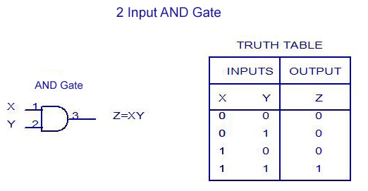
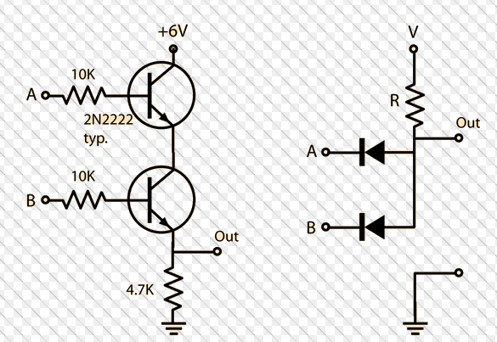
X
X
Z
Y
Y
Z

Slide 6
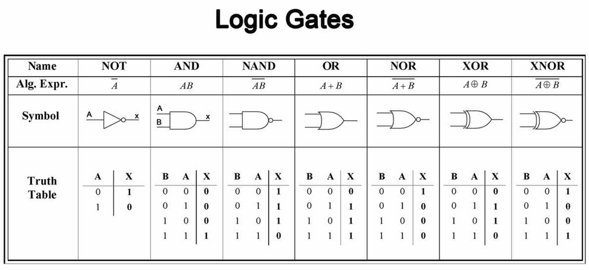

Slide 7
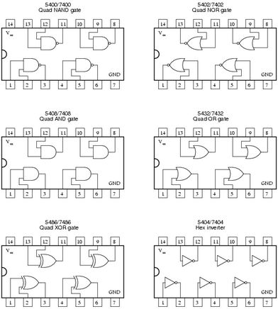
Electronic IC Chips

Slide 8
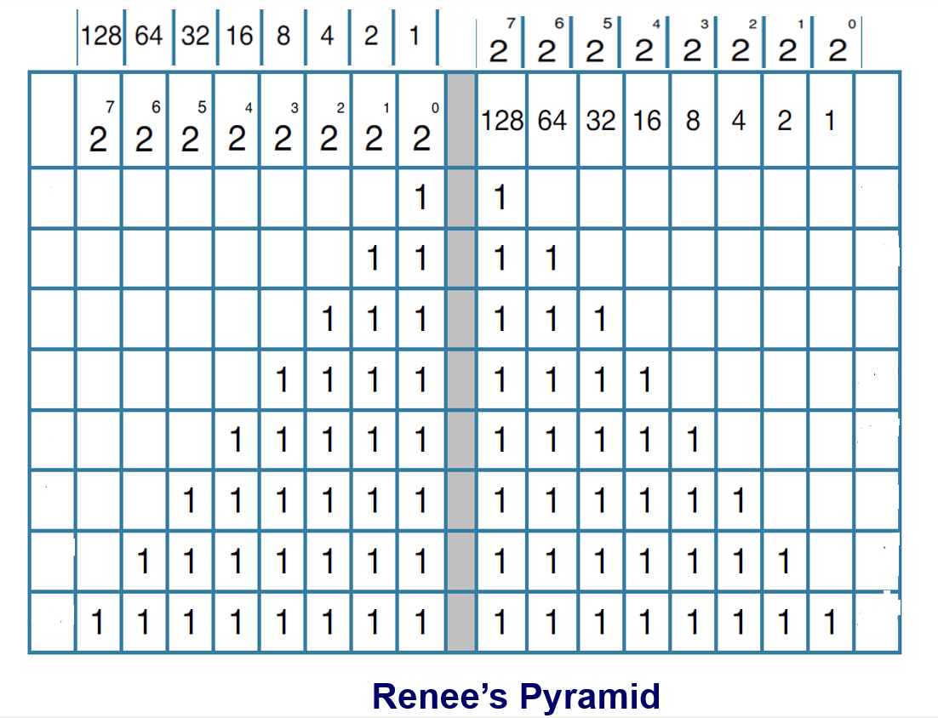
Renee’s Pyramid

Slide 9
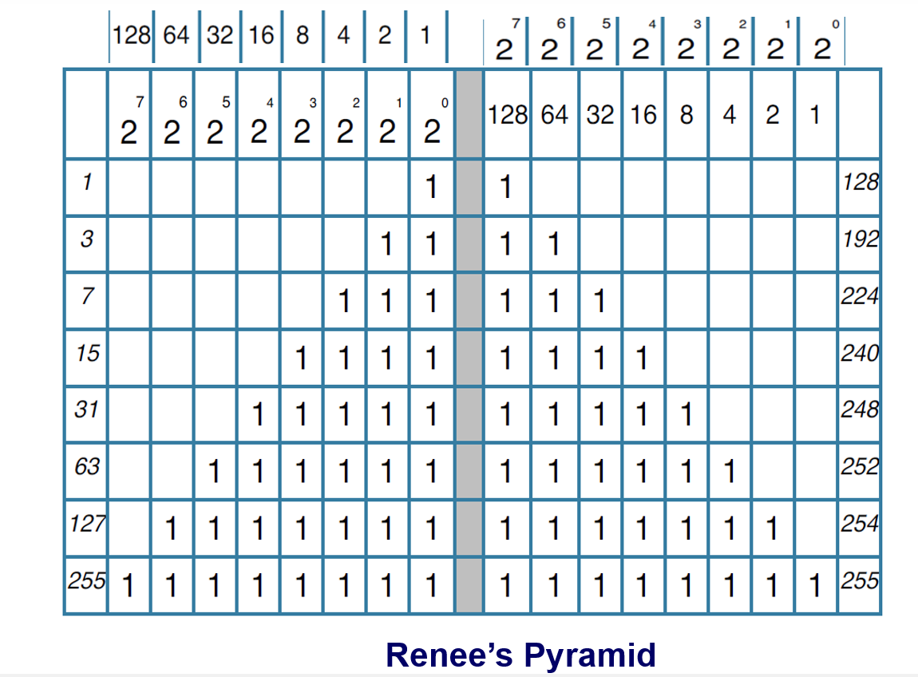

Slide 10
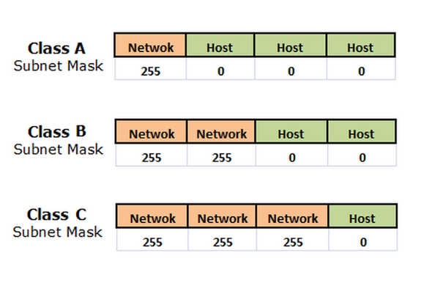

Slide 11
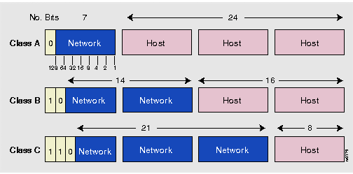
The Secret of Classification is Based on The First Octet
0
In the 1st Octet
10
In the 1st Octet
110
In the 1st Octet

Slide 12
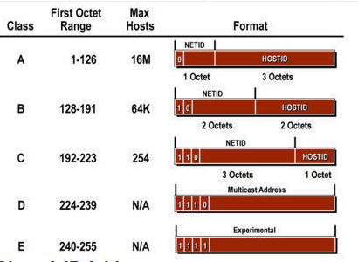

Slide 13
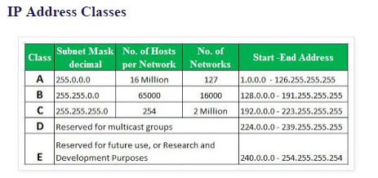
1-126
128-191
192-223

Slide 14
Subnetting of a Class C Network.
Class C Network : 192.168.32.0
Default Subnet Mask: 255.255.255.0
This network can contain a total of 254 hosts
From 192.168.32.1
To 192.168.32.254
With a broadcast address: 192.168.32.255

Slide 15
If we borrow two (2) bits, we will have the following situation:
192 168 32 0
Network: 1100 0000. 1010 1000. 0010 0000. 0000 0000
(NEW) Subnet Mask: 1111 1111.1111 1111. 1111 1111. 1100 0000 (255.255.255.192)
If we focus just on the 4th Octet, we have
0 0|0 0 0 0 0 0
additional mask 2 bits → 1 1|0 0 0 0 0 0
The possibilities we can have are four (4) :
0 0| (New mask in decimal)
0 1|
1 0|
1 1|
These translate to the following the following two (4) networks, namely,
192 168 32 0
Subnetwork No. 1: 1100 0000. 1010 1000. 0010 0000. 0000 0000
192 168 32 64
Subnetwork No. 2: 1100 0000. 1010 1000. 0010 0000. 0100 0000
192 168 32 128
Subnetwork No. 3: 1100 0000. 1010 1000. 0010 0000. 1000 0000
192 168 32 192
Subnetwork No. 4: 1100 0000. 1010 1000. 0010 0000. 1100 0000

Slide 16
If we want to complete the whole picture of the four (4) subnetworks, we show the following:
(Binary format) (decimal format)
for computer operations for human understanding
Subnetwork No. 1:
1100 0000. 1010 1000. 0010 0000. 0000 0000 192.168.32.0 (the Subnetwork Number 1)
1100 0000. 1010 1000. 0010 0000. 0000 0001 192.168.32.1 (the first valid host in
that subnetwork)
1100 0000. 1010 1000. 0010 0000. 0011 1110 192.168.32.62 (the last valid host in
that subnetwork)
1100 0000. 1010 1000. 0010 0000. 0011 1111 192.168.32.63 (the broadcast address for
that subnetwork)
Subnetwork No. 2:
1100 0000. 1010 1000. 0010 0000. 0100 0000 192.168.32.64 (the Subnetwork Number 2)
1100 0000. 1010 1000. 0010 0000. 0100 0001 192.168.32.65 (the first valid host in
that subnetwork)
1100 0000. 1010 1000. 0010 0000. 0111 1110 192.168.32.126 (the last valid host in
that subnetwork)
1100 0000. 1010 1000. 0010 0000. 0111 1111 192.168.32.127 (the broadcast address for
that subnetwork)

Slide 17
If we want to complete the whole picture of the four (4) subnetworks, we show the following (cont.):
(Binary format) (decimal format)
for computer operations for human understanding
Subnetwork No. 3:
1100 0000. 1010 1000. 0010 0000. 1000 0000 192.168.32.128 (the Subnetwork Number 3)
1100 0000. 1010 1000. 0010 0000. 1000 0001 192.168.32.129 (the first valid host in
that subnetwork)
1100 0000. 1010 1000. 0010 0000. 1011 1110 192.168.32.190 (the last valid host in
that subnetwork)
1100 0000. 1010 1000. 0010 0000. 1011 1111 192.168.32.191 (the broadcast address for
that subnetwork
Subnetwork No. 4:
1100 0000. 1010 1000. 0010 0000. 1100 0000 192.168.32.192 (the Subnetwork Number 4)
1100 0000. 1010 1000. 0010 0000. 1100 0001 192.168.32.193 (the first valid host in
that subnetwork)
1100 0000. 1010 1000. 0010 0000. 1111 1110 192.168.32.254 (the last valid host in
that subnetwork)
1100 0000. 1010 1000. 0010 0000. 1111 1111 192.168.32.255 (the broadcast address for
that subnetwork)

Slide 18
Pros and Cons on the Old-fashioned Method;
The Birth of The Ginger Method
Pros:
It is detailed
It is in binary form for computer
operations and
It is in decimal form for human understanding
Cons: the drawbacks are:
The method is slow and tedious
For examinations, such method
may take too much time
You may know your material and
still fail your certification exams
due to the time-consuming translation between
binary and decimal
To overcome the said problems, I have devised, with the inspiration I obtained in the long hours of cradling my youngest daughter Ginger with both hands, the Ginger Method of Subnetting. This method, if practiced well, can help you do subnetting in 60 seconds or less, without using a calculator. (I held my child with both of my two hands: my hands were used for caring my child; my mind was used to do subnetting mentally without pencil or paper)

Slide 19
Introduction to The Ginger Method
The Ginger Method involves answering seven (7) questions:
1- How many subnets?
2 ^{Subnet bits}
2- How many hosts per subnet?
2 ^{Host bits} - 2
3- What is the Ginger (G)? Or, G = 256 – last subnet mask
What is the spacing number?
What is the divisional number?
What is the base number?
What is the block number?
4- What are the subnets? 0, G, 2G, 3G….until subnet mask is reached.
5- What is the first valid host address?
Subnet + 1
6- What is the last valid host address?
Broadcast - 1
7- What is the broadcast address?
Next subnet – 1
The mathematical skills needed in the above operations are:
doubling, tripling, quadrupling….
Ability to add 1
Ability to subtract 1.
(The above method takes a number of practices before it is apparent to you. So be patient. And, let us work through a number of examples. O.K.)
This number does not change

Slide 20
Easy Subnetting by the Ginger Method: Example 1
Let us use the same example for the long and tedious method,
192.168.32.0
255.255.255.192
Sometimes, this is written as 192.168.32.0/26, or as 2 bit
subnetting in the 4th octet. (11111111.11111111.11111111.11000000 → 26 1’s)
Let us answer the seven (7) questions in the Ginger Method.
(1) how many subnets?
(2) how many hosts per subnet?
(3) Ginger = G = ?
(4) 0 G 2G 3G Subnetworks
(5) 1 G + 1 2G + 1 3G+1 First valid host
(6) (7) – 1 (7) – 1 (7) - 1 (7)-1 Last valid host
(7) G-1 2G – 1 3G – 1 4G-1 Broadcast address

Slide 21
Easy Subnetting by the Ginger Method: Example 1
Let us use the same example for the long and tedious method,
192.168.32.0
255.255.255.192
Sometimes, this is written as 192.168.32.0/26, or as 2 bit
subnetting in the 4th octet.
Let us answer the seven (7) questions in the Ginger Method.
(1)
(2)
(3)
(4)
(5)
(6)
(7)

Slide 22
Easy Subnetting by the Ginger Method: Example1
Let us use the same example for the long and tedious method,
192.168.32.0
255.255.255.192
Sometimes, this is written as 192.168.32.0/26, or as 2 bit
subnetting in the 4th octet.
Let us answer the seven (7) questions in the Ginger Method.
(1) 2 ² - 2 = 2 2 subnets
(2) 2 ⁶ – 2 = 62 62 hosts per subnet
(3) Ginger (G) = 256 – 192 = 64
192.168.32.0 192.168.32.64 192.168.32.128 192.168.32.192
Subnetwork Subnetwork Subnetwork Subnetwork
(4) 0 G = 64 2G=128 3G=192
(Notice that Subnet mask is
reached here !)
(5) 0+1=1 64 +1 = 65 128 +1 = 129 192+1=193 First valid host in the
subnetwork
(6) 63-1=62 127 – 1 =126 191 – 1 = 190 255-1=254 Last valid host in the
subnetwork
(7) 64-1=63 128 - 1 =127 192 – 1 = 191 256-1=255 Broadcast address of the
subnetwork

Slide 23
Easy Subnetting by the Ginger Method
Example 2
192.168.32.0
255.255.255.224
Sometimes, this is written as 192.168.32.0/27, or as 3 bit subnetting in the 4th octet.
Again, let us answer the 7 questions in the Ginger Method.
(1)
(2)
(3)
(4)
(5)
(6)
(7)

Slide 24
Easy Subnetting by the Ginger Method.
Example 2
192.168.32.0
255.255.255.224
Sometimes, this is written as 192.168.32.0/27, or as 3 bit subnetting in the 4th octet.
Again, let us answer the 7 questions in the Ginger Method.
(1) 2 ³ = 8
(2) 2 ⁵ – 2 = 30
(3) G = 256 - 224 = 32
(4) 0 32 64 96 128 160 192 224 256
(5) 1 33 65 97 129 161 193 225
(6) 30 62 94 126 158 190 222 254
(7) 31 63 95 127 159 191 223 255

Slide 25
Easy Subnetting by the Ginger Method
Example 3
192.168.32.0
255.255.255.240
Sometimes, this is written as 192.168.32.0/28, or as 4 bit subnetting in the 4th octet.
Let us answer the 7 questions in the Ginger Method.
Limit our answers to the first two subnetworks and the last subnetwork.
(1)
(2)
(3)
(4)
(5)
(6)
(7)

Slide 26
Easy Subnetting by the Ginger Method
Example 3
192.168.32.0
255.255.255.240
Sometimes, this is written as 192.168.32.0/28, or as 4 bit subnetting in the 4th octet.
Let us answer the 7 questions in the Ginger Method.
Limit our answers to the first two subnetworks and the last subnetwork.
(1) 2 ⁴ = 16
(2) 2 ⁴ – 2 = 14
(3) G = 256 -240 = 16
(4) 0 16 32 48... 224 240 256 Subnetwork
(5) 1 17 33 49… 225 241 First Host
(6) 14 30 46 61… 238 254 Last Host
(7) 15 31 47 62… 239 255 Broadcast

Slide 27
Easy Subnetting by the Ginger Method
Example 4
192.168.32.0
255.255.255.248
Sometimes, this is written as 192.168.32.0/29, or as 5 bit subnetting in the 4th octet.
Let us answer the 7 questions in the Ginger Method.
Limit our answers to the first two subnetworks and the last subnetwork.
(1)
(2)
(3)
(4)
(5)
(6)
(7)

Slide 28
Easy Subnetting by the Ginger Method
Example 4
192.168.32.0
255.255.255.248
Sometimes, this is written as 192.168.32.0/29, or as 5 bit subnetting in the 4th octet.
Let us answer the 7 questions in the Ginger Method.
Limit our answers to the first two subnetworks and the last subnetwork.
(1) 2 ⁵ = 32
(2) 2 ³ – 2 = 6
(3) G = 256 - 248 = 8
(4) 0 8 16 24…. 240 248 256
(5) 1 9 17 241 249
(6) 6 14 22 246 254
(7) 7 15 23 247 255

Slide 29
Easy Subnetting by the Ginger Method
Example 5
192.168.32.0
255.255.255.252
Sometimes, this is written as 192.168.32.0/30, or as 6 bit subnetting in the 4th octet.
Let us answer the 7 questions in the Ginger Method.
Limit our answers to the first two subnetworks and the last subnetwork.
(1)
(2)
(3)
(4)
(5)
(6)
(7)

Slide 30
Easy Subnetting by the Ginger Method
Example 5
192.168.32.0
255.255.255.252
Sometimes, this is written as 192.168.32.0/30, or as 6 bit subnetting in the 4th octet.
Let us answer the 7 questions in the Ginger Method.
Limit our answers to the first two subnetworks and the last subnetwork.
(1) 2 ⁶ = 64
(2) 2 ² – 2 = 2
(3) G = 256 - 252 = 4
(4) 0 4 8 12… 248 252 256
(5) 1 5 9 249 253
(6) 2 6 10 250 254
(7) 3 7 11 251 255

Slide 31
Easy Subnetting by the Ginger Method
Example 6
This time, we have a host address and a subnet mask
as shown:
192.168.32.79
255.255.255.192
How do you know which subnetwork does it belong?
(1)
(2)
(3)
(4)
(5)
(6)
(7)

Slide 32
Easy Subnetting by the Ginger Method
Example 6
This time, we have a host address and a subnet mask
as shown:
192.168.32.79
255.255.255.192
How do you know which subnetwork does it belong?
Instead of answering 7 questions in the Ginger Method, we only need to answer 5.
(1)
(2)
(3) G = 256 – 192 = 64
(4) 64 128
why do we stop at 128?
(5) 65
(6) 126
(7) 127
192.168.32.79 belongs to the 192.168.32.64 network.

Slide 33
Easy Subnetting by the Ginger Method
Example 7
This time, we have a host address and a subnet mask
as shown:
192.168.32.67
255.255.255.224
How do you know which subnetwork does it belong?
Instead of answering 7 questions in the Ginger Method, we only need to answer 5.
(1)
(2)
(3)
(4)
(5)
(6)
(7)

Slide 34
Easy Subnetting by the Ginger Method
Example 7
This time, we have a host address and a subnet mask
as shown:
192.168.32.67
255.255.255.224
How do you know which subnetwork does it belong?
Instead of answering 7 questions in the Ginger Method, we only need to answer 5.
(3) G = 256 – 224 = 32
(4) 0 32 64 96
(why did we stop here?)
(5) 65
(6) 94
(7) 95
192.168.32.67 belongs to the 192.168.32.64 subnetwork.

Slide 35
Easy Subnetting by the Ginger Method
Example 8
This time, we have two host addresses and the same subnet mask as shown:
192.168.32.39 192.168.32.45
255.255.255.240 255.255.255.240
How do you know which subnetwork does each host belong?
How do you know if the two hosts can communicate?
Please bear in mind that two hosts can communicate in a LAN, if and only if they belong to the same network or subnetwork.
Instead of answering 7 questions in the Ginger Method, we only need to answer 5.
(3)
(4)
(5)
(6)
(7)

Slide 36
Easy Subnetting by the Ginger Method
Example 8
This time, we have two host addresses and the same subnet mask as shown:
192.168.32.39 192.168.32.45
255.255.255.240 255.255.255.240
How do you know which subnetwork does each host belong?
How do you know if the two hosts can communicate?
Instead of answering 7 questions in the Ginger Method, we only need to answer 5.
(3) G = 256 – 240 = 16
(4) 16 32 48
(why did we stop here?)
(5) 33
(6) 46
(7) 47
The two hosts can communicate because they belong to the same subnetwork, 192.168.32.32, because 192.168.32.39 and 192.168.32.45 are between 192.168.32.33 and 192.168.32.46.
It will be not obvious to you if you use the long method.

Slide 37
Easy Subnetting by the Ginger Method
Example 9
This time, we have two host addresses and the same subnet mask as shown:
192.168.32.17 192.168.32.27
255.255.255.248 255.255.255.248
How do you know which subnetwork does each host belong?
How do you know if the two hosts can communicate?
Instead of answering 7 questions in the Ginger Method, we only need to answer 5.
(3)
(4)
(5)
(6)
(7)

Slide 38
Easy Subnetting by the Ginger Method
Example 9
This time, we have two host addresses and the same subnet mask as shown:
192.168.32.17 192.168.32.27
255.255.255.248 255.255.255.248
How do you know which subnetwork does each host belong?
How do you know if the two hosts can communicate?
Instead of answering 7 questions in the Ginger Method, we only need to answer 5.
(3) G = 256 – 248 = 8
(4) 8 16 24 32
(5) 17 25
(6) 22 30
(7) 23 31
The two hosts cannot communicate because they belong to the two different subnetworks, 192.168.32.16 and 192.168.32.24.
192.168.32.17 belongs to the 192.168.32.16 subnetwork; 192.168.32.27 belongs to the 192.168.32.24 subnetwork.
It will be not obvious to you if you use the long method.

Slide 39
Easy Subnetting by the Ginger Method
Example 10
This time, we have two host addresses and two different subnet masks as shown:
192.168.32.21 192.168.32.18
255.255.255.248 255.255.255.252
How do you know which subnetwork does each host belong?
How do you know if the two hosts can communicate?
Instead of answering 7 questions in the Ginger Method, we only need to answer 5.
(3)
(4)
(5)
(6)
(7)

Slide 40
Easy Subnetting by the Ginger Method
Example 10
This time, we have two host addresses and two different subnet masks as shown:
192.168.32.21 192.168.32.18
255.255.255.248 255.255.255.240
How do you know which subnetwork does each host belong?
How do you know if the two hosts can communicate?
Instead of answering 7 questions in the Ginger Method, we only need to answer 5.
(3) G = 256 – 248 = 8 G = 256 – 240 = 16
(4) 8 16 24 16 32
(5) 17 17
(6) 22 18
(7) 23 31
Surprisingly, the two hosts can communicate because they belong to the same subnetwork, 192.168.32.16, in spite of the different subnet masks.
192.168.32.21 belongs to the 192.168.32.16 subnetwork; 192.168.32.18 belongs to the same 192.168.32.16 subnetwork.
It will be not obvious to you if you use the long method.

